Slide 1


CLICK HERE TO BEGIN
LOADING

Slide 2

A Presentation On
Air Pollution Monitoring System

Slide 3
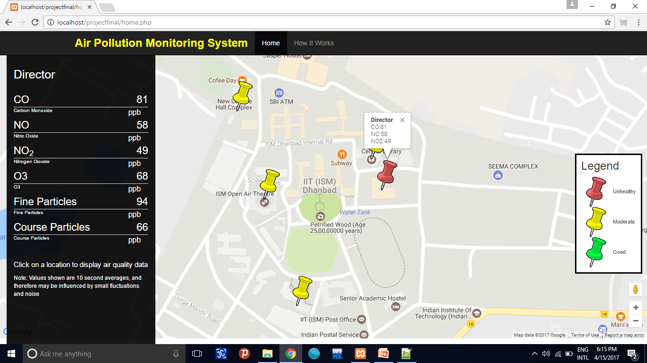
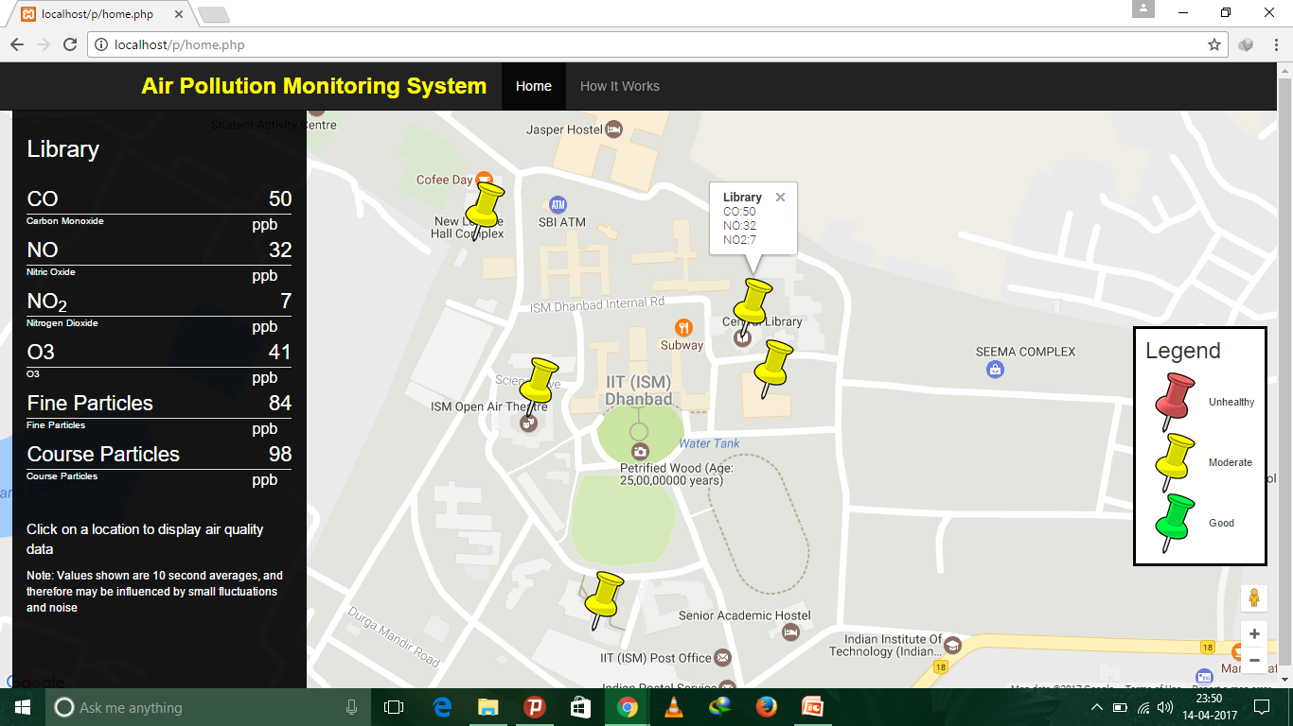
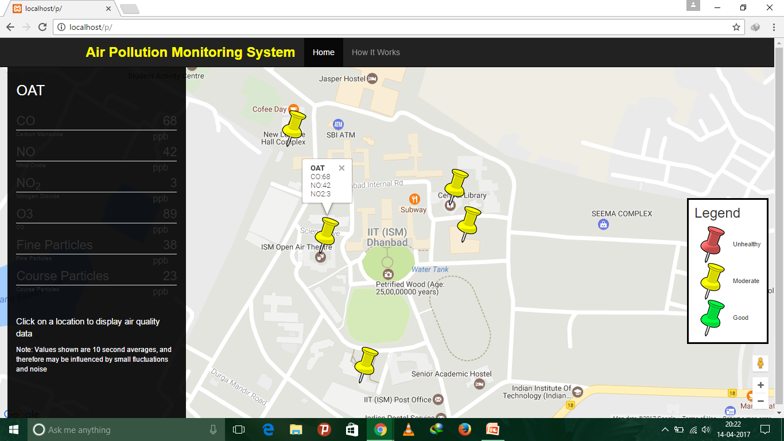
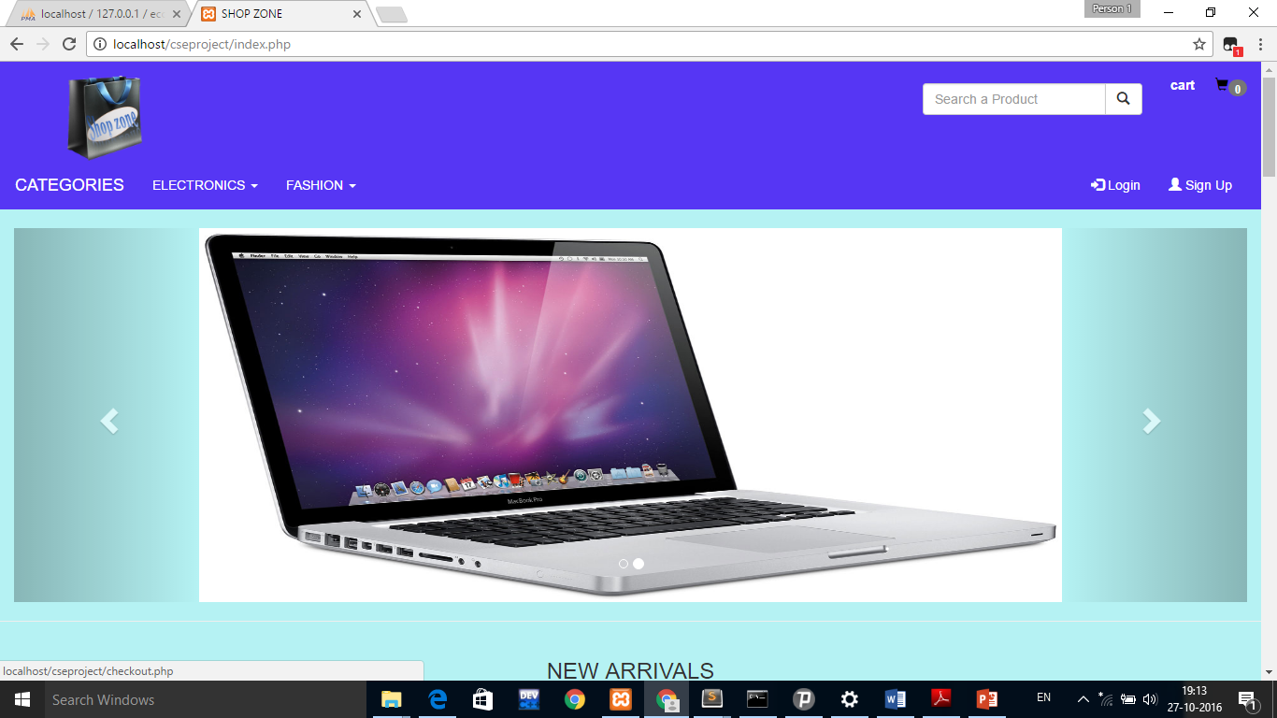
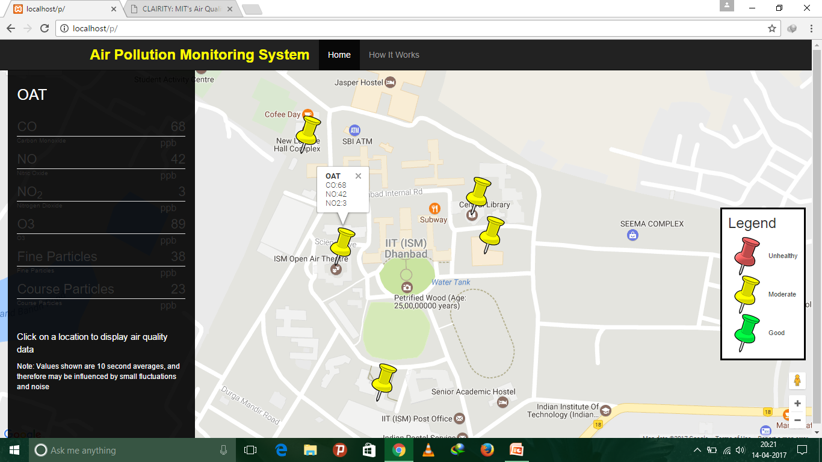
HOME PAGE

Slide 4
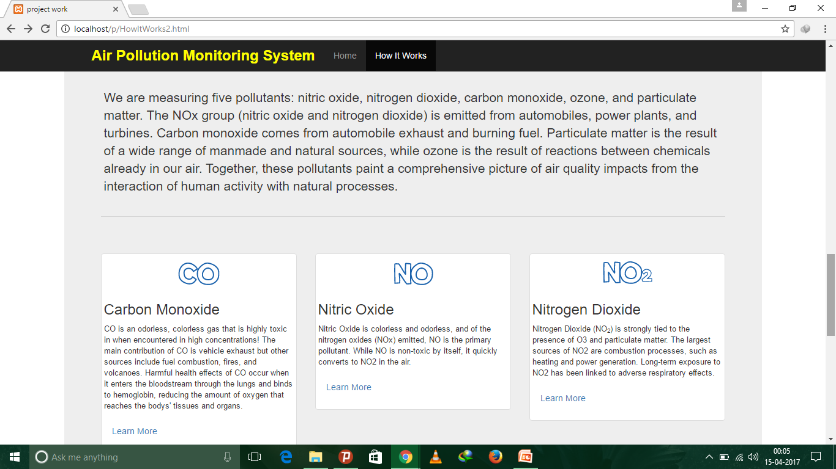
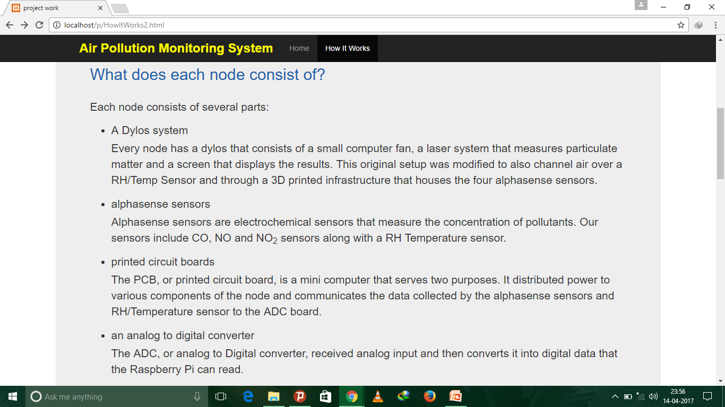
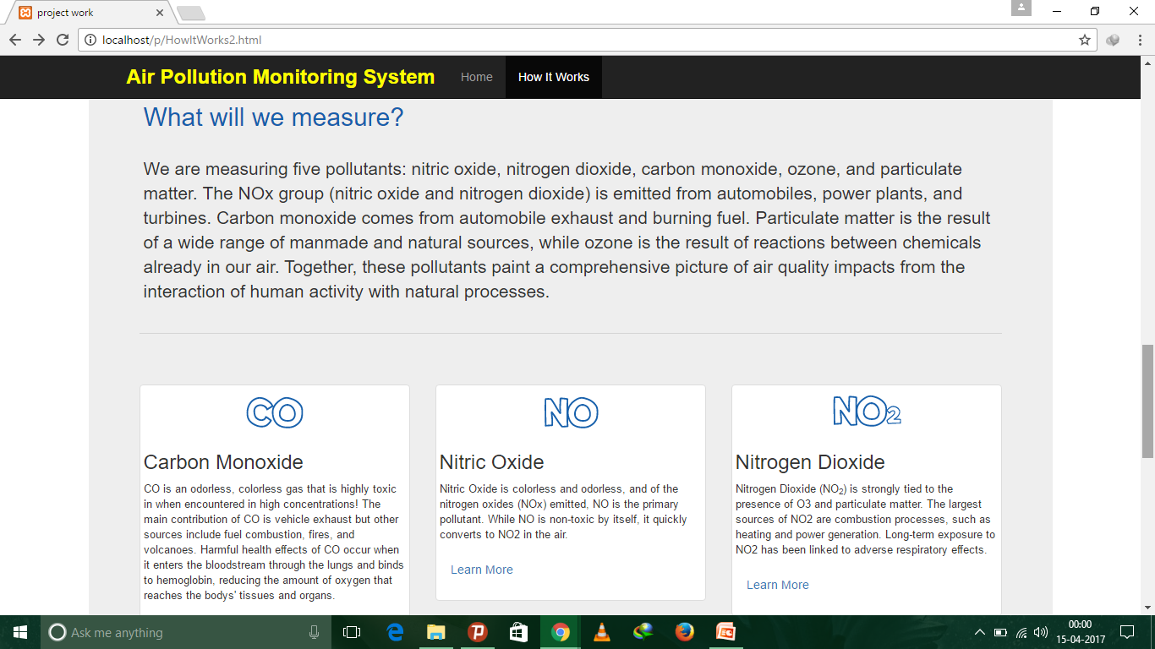
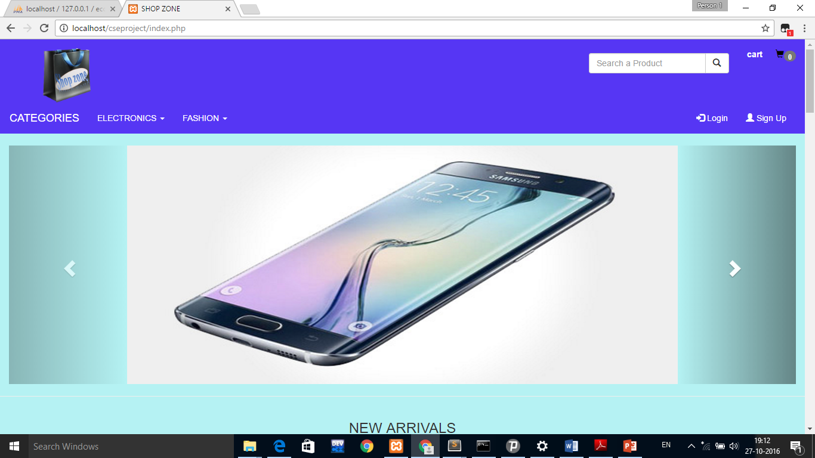
What will we measure
SEARCH HERE

Slide 5
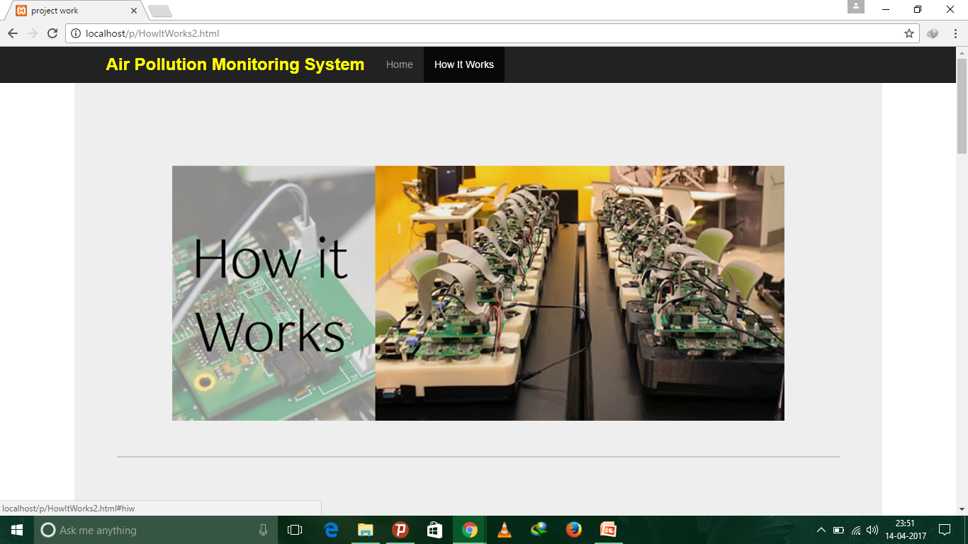
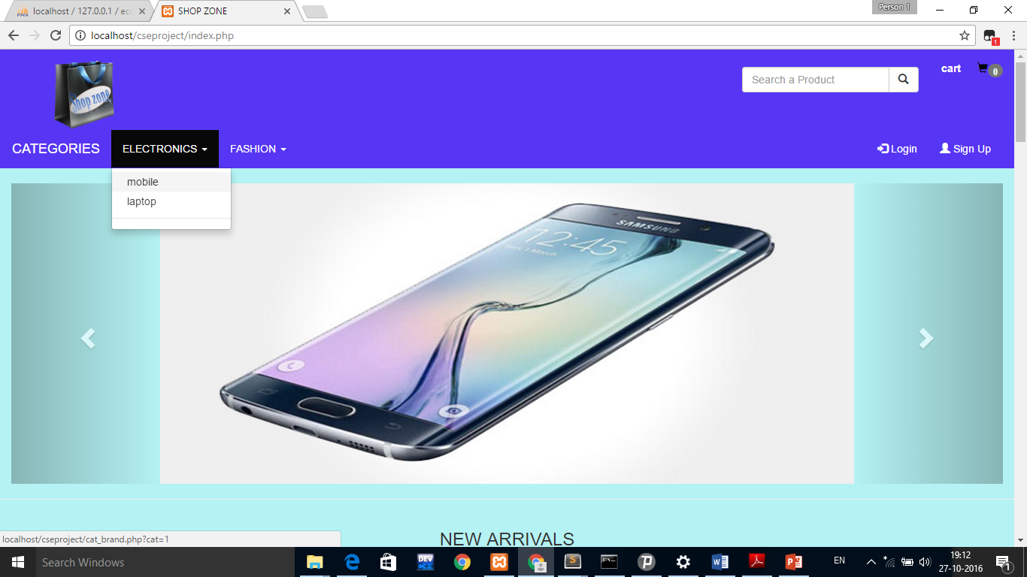
How it works
SELECT CATEGORY

Slide 6
RDBMS
RDBMS stands for Relational Database Management System.
RDBMS is the basis for SQL, and for all modern database systems such as MS SQL Server, IBM DB2, Oracle, MySQL, and Microsoft Access.
The data in RDBMS is stored in database objects called tables. A table is a collection of related data entries and it consists of columns and rows.

Slide 7
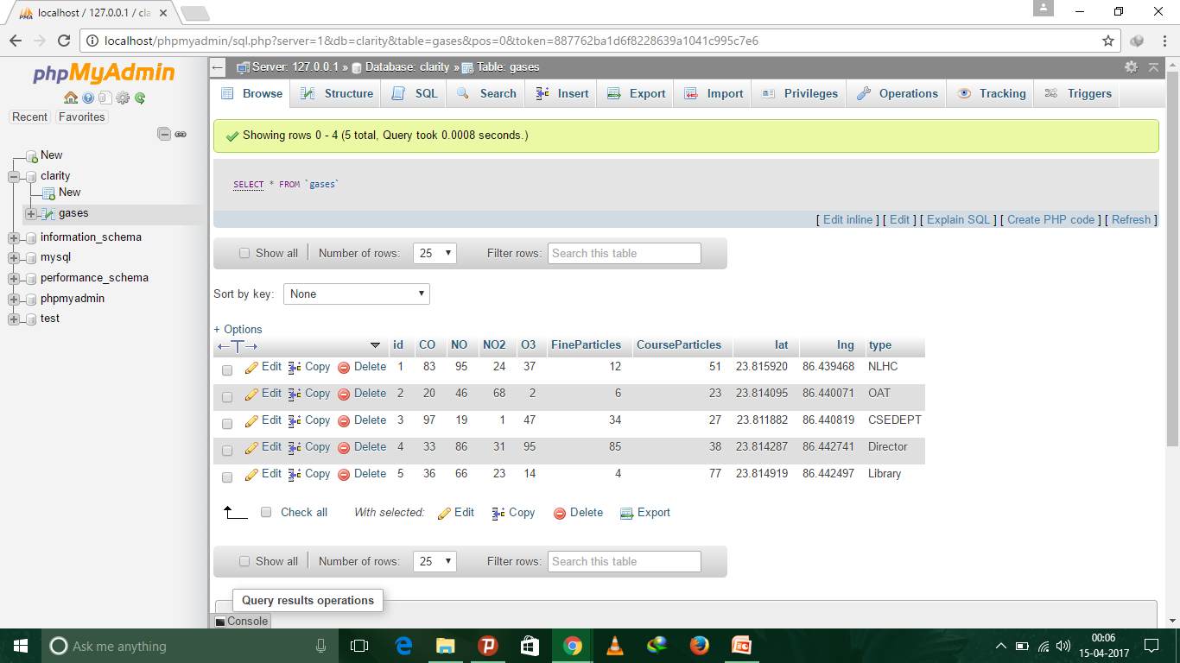
database
LOGIN
S
IGNUP

Slide 8
Backend Development
What makes the front end of a website possible? Where is all that data stored? This is where the back end comes in. The back end of a website consists of a server, an application, and a database. A back-end developer builds and maintains the technology that powers those components which, together, enable the user-facing side of the website to even exist in the first place.
In software engineering, the terms front end and back end refers to the separation of concerns between the presentation layer (front end), and the data access layer (back end) of a piece of software, or the physical infrastructure or hardware. In the client–server model, the client is usually considered the front end and the server is usually considered the back end. A rule of thumb is that the front (or "client") side is any component manipulated by the user. The server-side (or "back end") code usually resides on the server, often far removed physically from the user.

Slide 9
Programming Languages used
SQL
PHP
XML

Slide 10
SQL
SQL stands for Structured Query Language. It is a programming language that allows interaction with databases by storing, manipulating and retrieving data from databases.
It is an ANSI (American National Standards Institute) standard.
SQL can execute queries against a database
SQL can retrieve data from a database
SQL can insert records in a database

Slide 11
SQL can update records in a database
SQL can delete records from a database
SQL can create new databases
SQL can create new tables in a database
SQL can create stored procedures in a database
SQL can create views in a database
SQL can set permissions on tables, procedures, and views

Slide 12
PHP
PHP (recursive acronym for PHP: Hypertext Preprocessor) is a widely-used open source general-purpose server side scripting language that is especially suited for web development and can be embedded into HTML. What distinguishes PHP from something like client-side JavaScript is that the code is executed on the server, generating HTML which is then sent to the client. The client would receive the results of running that script, but would not know what the underlying code was.

Slide 13
XML
XML stands for eXtensible Markup Language. It is a software and hardware-independent tool for storing and transporting data. XML is a markup language much like HTML which was designed to store and transport data. XML is just information wrapped in tags, it does not do anything. However, it can be used for easy transfer of data from server side to client side.

Slide 14

Other Ways of Air Pollution control
and Management
Use craft supplies in well-ventilated areas.
Make sure your gas stove is well-ventilated.
Minimize clutter.
Remove carpeting if possible.
Use a dehumidifier and/or air conditioner to reduce moisture
Avoid smoking indoors.

Slide 15
conclusion
The proposed Wireless Air Pollution Monitoring System
provides the real-time information about the level of pollution in air,
as well as provides alerts in cases of drastic change in quality of air.
This information can then be used by authorities to take prompt
actions such as evacuating people and sending emergency response
team . It uses an air quality index to categorize the various levels of
air pollution .

Slide 16
References
Robin Nixon ;Learning PHP ,MySQL and Javascript
W3schools.com
Codeacademy.com etc...

Slide 17

THANK YOU

